Slide 1
General Kinetics Overview

Slide 2
Parameters to modulate
Temp
pH
Ionic Strength
Desired Ranges
Temp (20C and ~40C)
pH (6.5, 7.4, 8.0) Expand range.
Ionic Strength (175mM, 90mM, 40mM)
Temp (2 slides)
pH (3 slides)
Ionic strength (3 slides)

Slide 3
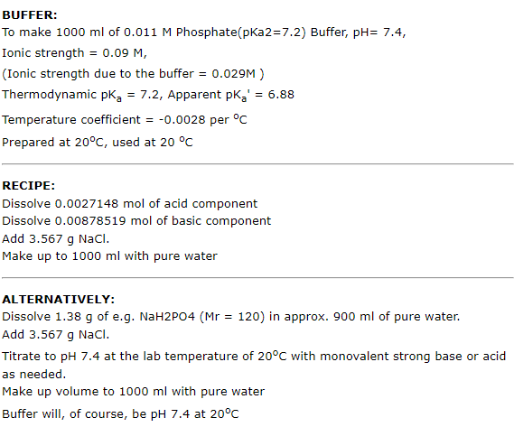
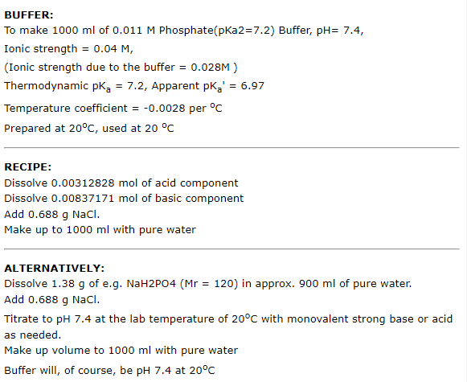
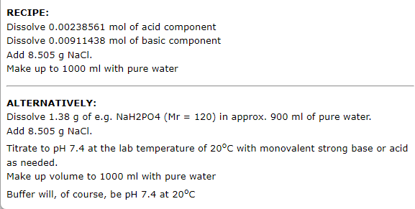
Buffer Formulation
175mM Ionic Strength (1x PBS)
90mM Ionic Strength (1x PBS)
40mM Ionic Strength (1x PBS)
Do corrections for ionic strength differences via pH modulation? It’s the order of 10mM.

Slide 4
Controls
Use range of pHs on fluorometer to graph intensity vs pH to adjust for altered fluorophore emission.

